Slide 1
Avoiding OCL specification pitfalls
Teaching Software Modeling by Using Constraints
Dan CHIOREAN, Ileana OBER and Vladiela PETRASCU

Slide 2
Teaching Software Modeling by Using Constraints Motivation
MDE technologies requires a clear and complete model specification
Design by Contracts supports producing rigorous models
Using this technique is not so widespread as expected
this state of facts was caused by different rationales
people are not yet convinced about the advantages that can be obtained
=> they should be motivated about using constraints
this shape their mentality

Slide 3
Teaching Software Modeling by Using Constraints Our proposal
To prove the necessity of employing constraints, by means of relevant examples
To presents best principles &
valid practices for specifying constraints
Our approach is focused on the:
role of complete and unequivocal requirements,
importance of the rigor in specifying constraints,
specification process that supports the return in earlier phases, including requirements
And highlights on the:
conformance between requirements & specifications,
importance of choosing a design model from different proposals,
need of testing specifications by using snapshot

Slide 4
Teaching Software Modeling by Using Constraints OCL specifications – state of facts
very good books, articles and slides about OCL: Warmer, Gogolla, Hussmann, Demuth, Atkinson, etc
many OCL examples (including the UML static semantics specification) are hasty,
avoiding hasty specification through some best practice & principles
Aspects related to OCL specs
usefulness of information when constraints are broken
intelligibility and suggestiveness of specification
use of constraint specification patterns
conformity between evaluation of constraints specified:
in OCL and
in programming languages (generated from specs)
the independence of the results obtained from the OCL tools used

Slide 5
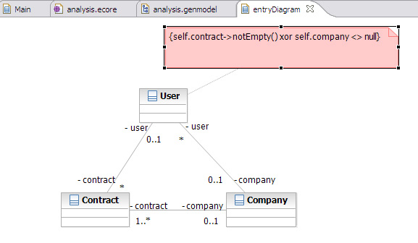
Teaching Software Modeling by Using Constraints Modeling requires understanding the problem and the problem domain
“… the library offers a subscription to each person employed in an associated company. In this case, the employee does not have a contract with the library but with the society he works for, instead.”
Notes:
The first information missing about this model is that concerning its probable usage. In our opinion, this concerns the information system of a library, that stores
information about library users, associated companies, books, book copies and loans. The library may have many users and different associated companies. Also, the relationships between different concepts are missing or vague described – how many contracts may have a user, why? What’s the upper limit of participants at a contract? The natural role names of the association between the user and the company are employer & employee a.s.o.

Slide 6
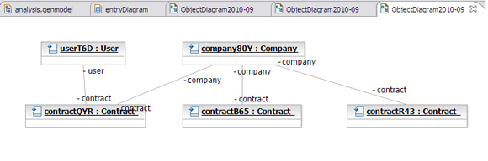
Teaching Software Modeling by Using Constraints Understanding the concepts and improving the requirements
snapshots must clarify requirements and the model
context User
inv TodConstraint:
self.contract->notEmpty() xor self.company <> null
Notes:
In the snapshot presented in this slide, the contractQVR between userT6D and company80Y contradicts the informal requirements because the userT6D is not employed by the company80Y. As the library was not modeled, the contractual relationships with the library cannot be specified in a natural manner.

Slide 7
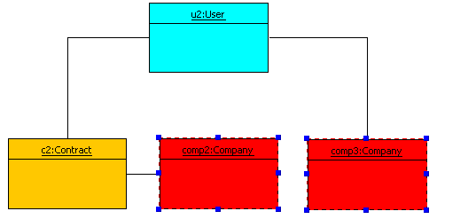
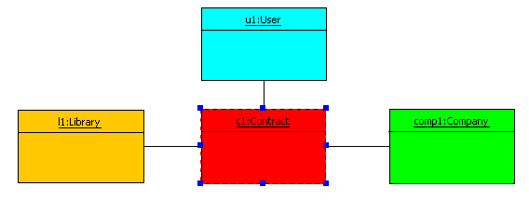
Teaching Software Modeling by Using Constraints Using suggestive snapshots to test specifications
Unwanted model instantiations that are not cached by the invariant proposed in [Tod11]
context User
inv TodConstraint:
self.contract->notEmpty() xor self.company <> null
Notes:
The snapshots represented in this side present two unwanted instantiation. The snapshot from the left part shows an instantiation that is not reported by the invariant proposed in the same paper because the library concept was not included in the model. The snapshot from the right part presents a situation in which the user u2 employed by the company comp3 has the contract c2 with the company comp2 and not with comp3.

Slide 8
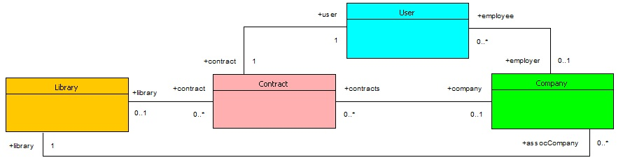
Teaching Software Modeling by Using Constraints Understanding and improving the requirements_3
Improving the solution proposed by choosing an appropriate context & updating constraints,
context Contract
inv onlyOneSecondParticipant:
self.library->isEmpty xor self.company->isEmpty
context User
inv theContractIsWithTheEmployer:
if self.employer->isEmpty
then self.contract.library->notEmpty
else self.employer = self.contract.company
endif
Notes:
Apart from the model proposed in [Tod11], the model included in this slide, includes the library concept. Also, the role name and the multiplicity of roles were changed in order to comply with the requirements and with the understanding of the problem domain. Concerning the invariant restricting the contract participants this was specified in the Contract context and not in the User context like in [Tod11]. The constraint requiring that the contract of a user employed by a company is between the above mentioned user and company was specified in the User context.

Slide 9
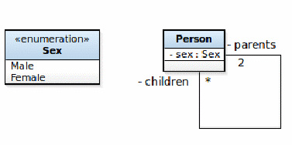
Teaching Software Modeling by Using Constraints Understanding model semantics
in MDD technologies models are used to produce software
self.parents->asSequence()->at(1).sex <>
self.parents->asSequence()->at(2).sex
context Person
inv parentsSex:
self.parents->size = 2 implies
self.parents->first.sex = Sex::female and
self.parents->last.sex = Sex::male
Notes:
Models proposed in MDD technologies are meant to produce software. That’s why the model proposed [Tod11] is inappropriate because induce an infinite recursion. Moreover, the OCL specification has some drawbacks: accessing the elements of the collection will trigger an exception if at least one parent is unknown. Another aspect concerns the comparison of an undefined value with a defined value, that returns different results in different tools (OCLE & USE). Parents collection can be ordered; the first parent playing the role of mother and the second the father. However, this specification cannot be applied if only one parent is known.

Slide 10
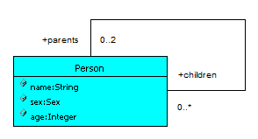
Teaching Software Modeling by Using Constraints Understanding model semantics_2
context Person
inv notSelfParent:
self.parents->select(p | p = self)->isEmpty
context Person
inv parentsAge:
self.parents->reject(p|p.age - self.age >= 16)->isEmpty
context Person::addChildren(p:Person)
pre childrenAge:
self.children->excludes(p) and self.age - p.age >= 16
post chidrenAge:
self.children->includes(p)
Notes:
Forbidding a person to be its own parent can be specified in in different manners. The second invariant, imposing a constraint on the values of the age property of parent and children is finer.

Slide 11
Teaching Software Modeling by Using Constraints Explaining the Intended Model Uses
The result obtained when querying
context Person
def allAncestors():Sequence(Person) =
self.parents->union(self.parents.allAncestors())
context Person
def allAncestors():Sequence(Person) =
(Sequence{self}->closure(p | p.parents))->asSequence

Slide 12
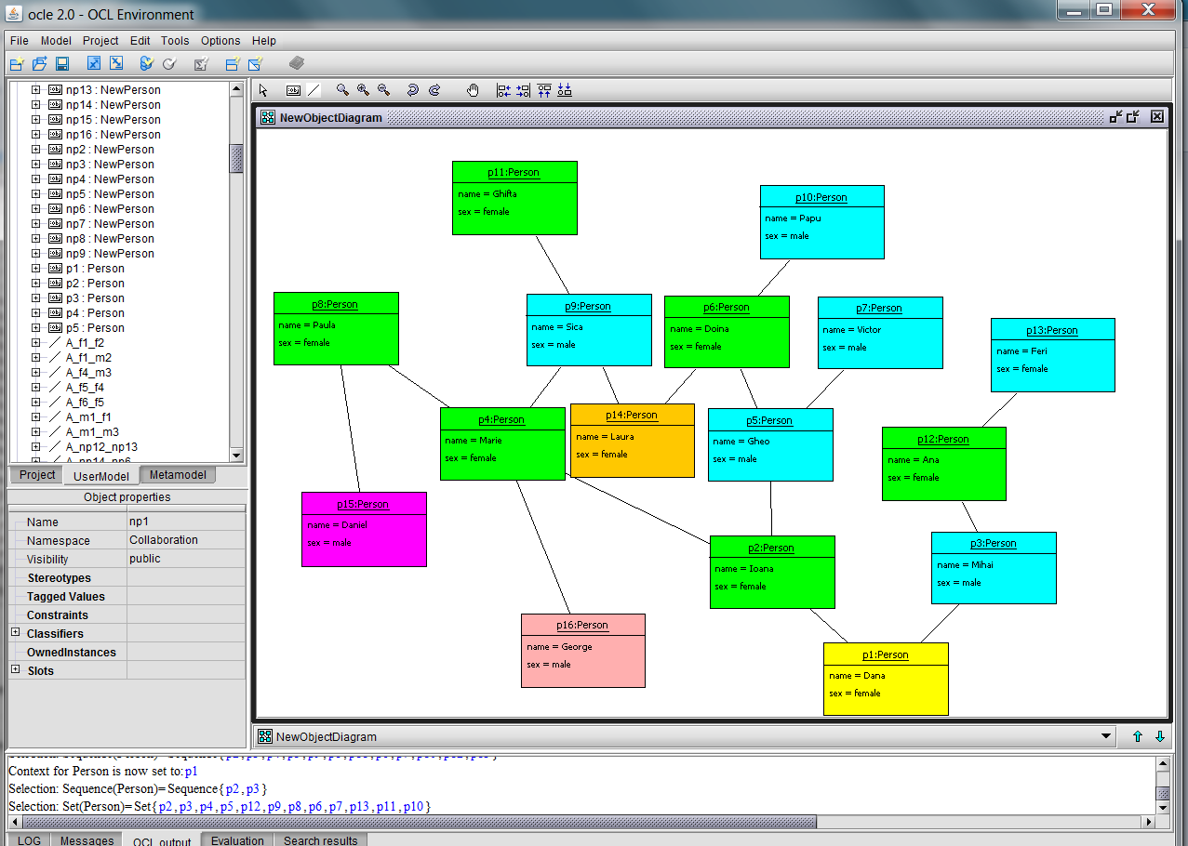
Teaching Software Modeling by Using Constraints Querying the initial model
Notes:
The result obtained by querying the initial design of the Person tree is not so suggestive like in case of the second design because the info missing are not specified clearly.

Slide 13
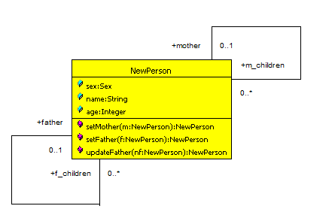
Teaching Software Modeling by Using Constraints Explaining the Intended Model Uses_2
context NewPerson
def parents:TupleType(mother:Nperson, father:NPerson) =
Tuple{mother = self.mother, father = self.father}
def allAncestors:Sequence(TupleType(mother:Nperson, father:NPerson))= Sequence{self.parents}->closure(i | i.mother.parents, i.father.parents))->asSequence-> prepend(self.parents)

Slide 14
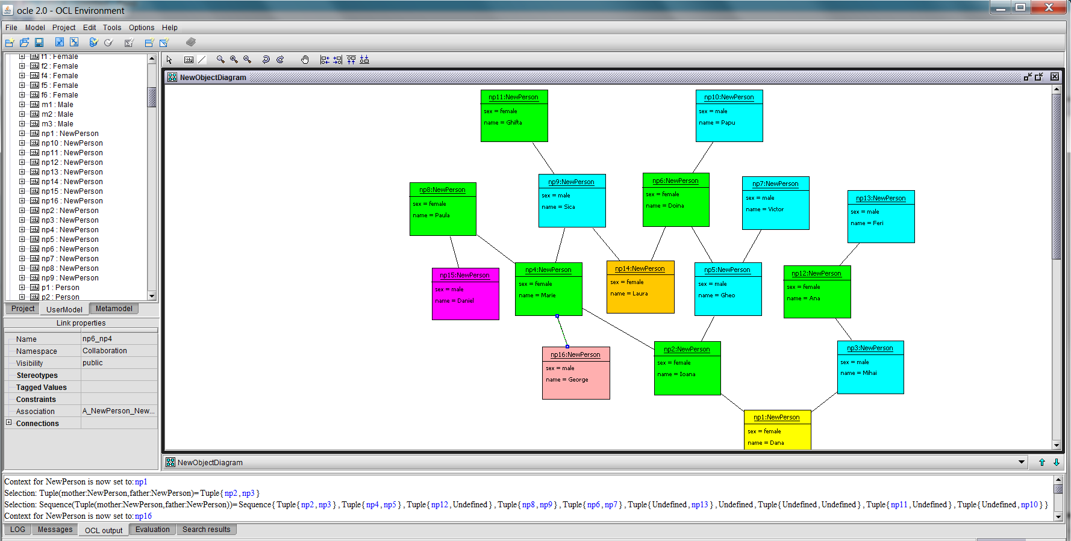
Teaching Software Modeling by Using Constraints The result obtained when querying the NewPerson tree
Notes:
The result obtained by querying the NewPerson tree is more suggestive compared with the result obtained by querying the previous Person tree

Slide 15
Teaching Software Modeling by Using Constraints Conclusion
Complementing model specification with constraints is crucial. This supports:
a rigorous model description and
detection of unwanted model instantiation
Conformance with requirements is the first criterion quality criterion in constraint specification
This requires a thorough understanding of the problem and problem domain
Abstraction is the first principle that have to be applied when modeling because identify the main concepts to use
Identifying and specifying constraints follow abstraction because restricts on relationships between concepts and on their values

Slide 16
Teaching Software Modeling by Using Constraints Conclusion_2
The main attitude in specifying constraints is the rigor
In our opinion, hastiness is the main enemy in the constraint specification process
The quality of constraint specification includes also different other criteria
Requirements have to include the description of the intended usage of the system
The constraints role is to support a better quality of the model
When judging the quality of the model, all descriptions including constraints must be considered
Choosing the most appropriate model, supposes analyzing many proposals

